Slide 1
Tips for Using Stata
Li Tang
ltang@imf.org
Econometric Modeling and Support Team
econometricsupport@imf.org

Slide 2
Outline
Observation numbering
Checking data
assert
Identify duplicate observations
Handling missing data
Summary statistics
inlist, inrange
String functions
Dummy variable
reshape
Dates
Filling gaps, moving window, identifying runs of consecutive observations
Exporting regression results

Slide 3
Observation Numbering :_n and _N
The observation in the dataset are numbered 1,2,3…,21. The observation numbers will change is a sort commands alters the order of the dataset in memory.
The current observation number is known as _n. The higher observation number, corresponding to the total number of observations, is known as _N
Try it out:
import excel using "level 4.xlsx", ///
sheet("countrydata2") firstrow clear
bys country: gen id=_n
by country: gen max_obs=_N

Slide 4
Assert
sysuse auto, clear
* The documentation says make and model
* is a string and implies it is always defined:
assert make ~= ""
* documentation implies price is always defined.
assert price ~= . & price > 0
* similarly
assert mpg ~= . & mpg > 0
assert weight ~= . & weight > 0
assert displacement ~= . & displacement > 0
* false
assert foreign == 0

Slide 5
Identify Duplicate Observations
use dup,clear
order id year
sort id year
* a new var named dup is created,
* which equals 0 if unique value
quietly by id year: gen dup = cond(_N == 1,0,_n)
tab dup
br if dup != 0
drop if dup > 1

Slide 6
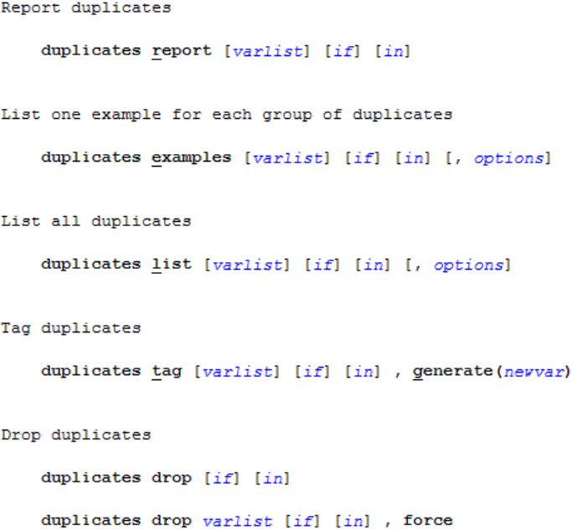

Slide 7
Handling Missing Data
A missing value has an infinite or the highest value in Stata
Most commands ignore missing values by default.
Missing values are denotes as . in Stata
Useful command: recode and destring
Try it out:
import excel using "level 4.xlsx", ///
sheet("missing") firstrow clear
destring inc,replace force
recode ln_inv (-9=.)

Slide 8
Summary Statistics to a New Dataset
Stata's collapse command computes aggregate statistics such as mean, sum, and standard deviation and saves them into a data set. When you execute the command, an existing data set is replaced with the new one containing aggregate data.
Try it out:
sysuse auto,clear
collapse (p25) p25_m=mpg p25_price=price ///
(first) f_wei=weight f_length=length, ///
by(foreign)

Slide 9
Summary Statistics as New Variables
egen allows you add a summary statistic as new variables to your data set
Try it out:
sysuse auto,clear
egen p15_price=pctile(price),p(15)
egen kurt_price= kurt(price)
egen sum_price=total(price)
egen min_price=min(price)

Slide 10
Exporting Summary Statistics
logout provides a fast and easy way to convert log or ASCII files into various output formats compatible with Word, Excel, LaTex, or Stata datafile.
With logout, you can capture and export almost anything that appears on your Stata screen, including the stuffs like summary, description, list, tabstat, tabulations, etc.
Try it out:
ssc install logout
logout, save(result) excel word replace: summarize
logout, save(result2) excel word replace: ///
tabulate foreign rep78

Slide 11
In a List or Out? In a Range or Out?
The question answered by inlist() is whether a speciﬁed argument belongs to a speciﬁed list. That answered by inrange() is whether a speciﬁed argument falls in a speciﬁed range.
Try it out:
sysuse auto,clear
list make rep78 if rep78 == 3 | rep78 == 4 | ///
rep78 == 5
list make rep78 if rep78 >= 3 & rep78 <= 5
list make rep78 if inlist(rep78, 3, 4, 5)
list make rep78 if inrange(rep78, 3, 5)
*identify the first and last observation
gen price_se = price if inlist(_n, 1, _N)

Slide 12
String to Numeric Conversion
A data file may have some of the variables defined as strings, that is, character variables.
Converting string variables with numeric values into a numeric variable
Converting string variables with non-numeric values into numeric values
Try it out:
import excel "level 4.xlsx", sh("string") first clear
* remove s in the beginning
gen id_temp= substr(id,2,.)
gen subid=real(id_temp)
encode name, generate(name2)
list name2,nolab
* remove s in the end
gen id_temp2 = strreverse(id2)
//then follow the steps above and reverse it back
* remove s
gen id_temp3 = subinstr(id2, "s", "", .)

Slide 13
Numeric to String Conversion
In the example below, we create string variables from numeric variables, and then concatenate string variables into one. By doing so, we can create a unique identifier that may be needed to merge several data sets.
Try it out:
import excel using "level 4.xlsx", ///
sheet("numeric") firstrow clear
gen str4 id2 = string(id)
gen str6 newid = country + id2

Slide 14
How to Create Dummy Variables
sysuse auto,clear
*Answer 1
gen dummy=0
replace dummy=1 if price>4000 & !missing(price)
*Answer 2
tabulate rep78, gen(rep)
*Answer 3: if you want to include dummies in a model
xi: regress price mpg i.rep78

Slide 15
How to Include Year Effects
clear
use http://www.statapress.com/data/r11/nlswork
xtreg ln_w age tenure not_smsa south, fe
xtreg ln_w age tenure not_smsa south i.year, fe
testparm i.year

Slide 16
Reorganizing Datasets with Reshape
Try it out:
import excel using "level 4.xlsx", ///
sheet("reshape") cellrange(A2:E5) firstrow ///
clear
reshape long inc, i(id) j(year)
reshape wide inc, i(id) j(year)

Slide 17
Dates
An elapsed date in Stata is a number of time periods elapsed since January 1, 1960 (01jan1960 = 0). The time-period used to compute elapsed dates is determined by the frequency of the data.
Date Type | Human Readable Form (HRF) | Stata Internal Form (SIF) | Explanation of SIF
date | 20jan2012 | 19012 | Days since 01jan1960
weekly date | 2012w3 | 2706 | Week since 1960w1
monthly date | 2012m1 | 624 | Months since 1960m1
quarterly date | 2012q1 | 208 | Quarters since 1960q1
half-yearly date | 2012h1 | 104 | Half-years since 1960h1
yearly date | 2012 | 2012 | Years since 0000

Slide 18
Dates: conversion
String-to-numeric date conversion functions
Desired SIF type | Functions
date | date(HRFstring, mask [, topyear])
weekly date | weekly(HRFstring, mask [, topyear])
monthly date | monthly(HRFstring, mask [, topyear])
quarterly date | quarterly(HRFstring, mask [, topyear])
half-yearly date | halfyearly(HRFstring, mask [, topyear])
yearly date | yearly(HRFstring, mask [, topyear])
mask specifies the order of the date and time components. For example, “MDY”, “MD19Y”, “YQ”.

Slide 19
Dates: conversion
Example
use dates, clear
gen edaily1 = date(daily1, "MDY")
gen edaily2 = date(daily2, "DMY")
gen edaily4 = date(daily4, "DMY", 2005)
gen equarterly = quarterly(qdate, "YQ")
gen emonthly = monthly(mdate, "MY", 2006)

Slide 20
Dates: format
Elapsed dates are just integer numbers. However, they can be formatted to appear as human-readable date strings using format command.
Example:
format %td edaily1
format %tm emonthly
format %tq equarterly
Date type | format
date | %td
weekly date | %tw
monthly date | %tm
quarterly date | %tq
half-yearly date | %th
yearly date | %ty

Slide 21
Dates: use
Example: collapse quarterly data into yearly
use demo.dta, clear
gen qdate = quarterly(obs, "YQ")
format %tq qdate
gen year = yofd(dofq(qdate))
collapse (sum)gdp (mean)pr, by(year)
function | return | example | Format | HRF
wofd(ed) | weekly date | wofd(19012)=2706 | %tw | 2012w3
mofd(ed) | monthly date | mofd(19012)=624 | %tm | 2012m1
qofd(ed) | quarterly date | qofd(19012)=208 | %tq | 2012q1
yofd(ed) | yearly date | yofd(19012)=2012 | %ty | 2012
dofw(ed) | date | dofw(2706)=19007 | %td | 15jan2012
dofm(ed) | date | dofm(624)=18993 | %td | 01jan2012
dofq(ed) | date | dofq(208)=18993 | %td | 01jan2012
dofy(ed) | date | dofy(2012)=18993 | %td | 01jan2012

Slide 22
Dates: use
Example: use literal dates
run regression using only the data from 1955q1
regress rs gdp m1 pr if qdate > 1955q1 //wrong
regress rs gdp m1 pr if qdate > -20
regress rs gdp m1 pr if qdate > q(1955q1)
function | return | example
d(daily_date_string) | elapsed date | d(20jan2012)=19012
w(weekly_date_string) | elapsed date | w(2012w3)=2706
m(monthly_date_sring) | elapsed date | m(2012m1)=624
q(quarterly_date_string) | elapsed date | q(2012q1)=208
y(yearly_date_string) | elapsed date | y(2012)=2012

Slide 23
Example
use dates, clear
gen edaily1 = date(daily1, "MDY")
format %td edaily1
* Extract year
gen year=year(edaily1)
* Extract month
gen month = mofd(edaily1)
format dm %tm

Slide 24
Filling in the Gaps
The command fillin adds observations with missing data so that all interactions of varlist exist, thus making a complete rectangularization of varlist. fillin also adds the variable fillin to the dataset. fillin is 1 for observations created by using fillin and 0 for previously existing observations.
The command can be used to create a balanced panel data
Try it out:
import excel using "level 4.xlsx", ///
sheet("gaps") cellrange(A1:c93) firstrow clear
fillin country year

Slide 25
Calculate Moving Window Summary Statistics
The user written command mvsumm can be used to calculate moving window summary statistics in your dataset. You must tsset your data before using mvsumm.
To install
ssc install mvsumm
Try it out:
webuse lutkepohl2,clear
tsset qtr
//ssc install mvsumm
mvsumm inv, stat(mean) win(3) gen(M_inv) end
mvsumm inv, stat(max) win(3) gen(Max_inv) end

Slide 26
Identify Runs of Consecutive Observations in Panel Data
Consider you have a panel dataset with some gaps, you want to look systematically at runs of consecutive observations, especially the length of the longest run in each panel.
To install
ssc install tsspell
Try it out:
webuse nlswork,clear
tsset
tsspell idcode
br idcode year _spell _seq _end

Slide 27
Making Regression Tables in Stata (I)
Try it out:
sysuse auto,clear
eststo clear
eststo:regress price mpg weight
eststo:regress price mpg weight if foreign==1
esttab using regout.csv

Slide 28
Making Regression Tables in Stata (II)
Try it out:
sysuse auto,clear
tab rep78, gen(repair)
regress mpg foreign weight repair1-repair4
outreg2 using myfile, drop(repair*) ///
replace excel
regress price mpg weight if foreign==1
outreg2 using myfile,excel

Slide 29
Preserve and Restore
preserve tells Stata to keep your data in memory, so if your next commands modify it, you can come back to your original data.
Try it out:
sysuse auto,clear
preserve
collapse (p25) p25_m=mpg p25_price=price ///
(first) f_wei=weight f_length=length, ///
by(foreign)
save auto_stat, replace
restore

Slide 30
Exercise ☺
Put multiple sheets in Excel into one dataset

